Slide 1

Serverless Voice Assistant with AWS Polly and Lex
P Harishith Chowdary (2210030050)
Under the esteemed guidance of
Ms. P. Sree Lakshmi
Assistant Professor,
Department of Computer Science and Engineering

Slide 2
Project Overview
People often need fast, hands-free ways to get information or perform tasks. Typing isn’t always convenient, especially in situations like driving or for visually impaired users. Voice assistants solve this problem with smart, spoken interaction.
This project aims to build a serverless voice assistant using AWS Lex and Polly. It takes voice input, processes it in the cloud, and responds with lifelike speech—no servers needed.
The assistant can be used in smart homes, customer service, or accessibility tools, showing real-world value as voice tech like Alexa and Siri becomes more common.

Slide 3
Services Used
Amazon Lex – For understanding voice/text input and managing conversation flow.
Amazon Polly – For converting text responses into lifelike speech.
AWS Lambda – For running backend logic without managing servers.
Amazon CloudWatch – For monitoring and logging function performance.
AWS IAM – For managing secure access and permissions between services.
Amazon API Gateway (optional) – For exposing the assistant as an API.

Slide 4
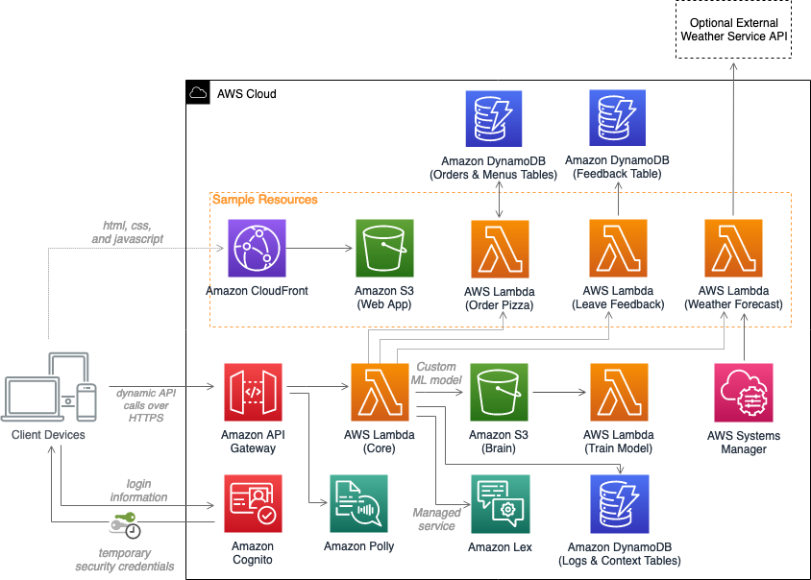
Flow Diagram

Slide 5
Implementation Process
Create Lex Bot
Define bot name, language, and voice interaction type.
Add intents, utterances, and slots to handle user input.
Set Up Lambda Function
Create an AWS Lambda function to process requests from Lex.
Add logic to generate responses or call other services if needed.
Integrate Polly
Use Amazon Polly in the Lambda function to convert response text into speech.
Return the audio output to Lex.
Configure IAM Roles
Assign proper IAM roles and permissions for Lex, Lambda, and Polly to communicate securely.
Test the Bot
Use the Lex console to test interactions with the voice assistant.
Check if the bot responds accurately and speaks the correct output.
Monitor with CloudWatch
Use Amazon CloudWatch to view logs and monitor performance.
Debug and optimize based on logs.

Slide 6
Key Features and Functionality
Voice Input Support Users can speak naturally to interact with the assistant.
Intent Recognition Amazon Lex accurately understands and processes user requests.
Text-to-Speech Output Amazon Polly converts responses into clear, lifelike speech.
Serverless Architecture AWS Lambda handles backend logic without server setup.
Scalability Automatically scales based on usage, no manual intervention needed.
Easy Integration Can be connected with websites, mobile apps, or IoT devices.
Secure Access IAM roles ensure safe communication between AWS services.
Monitoring & Logs CloudWatch tracks activity and helps troubleshoot issues.

Slide 7
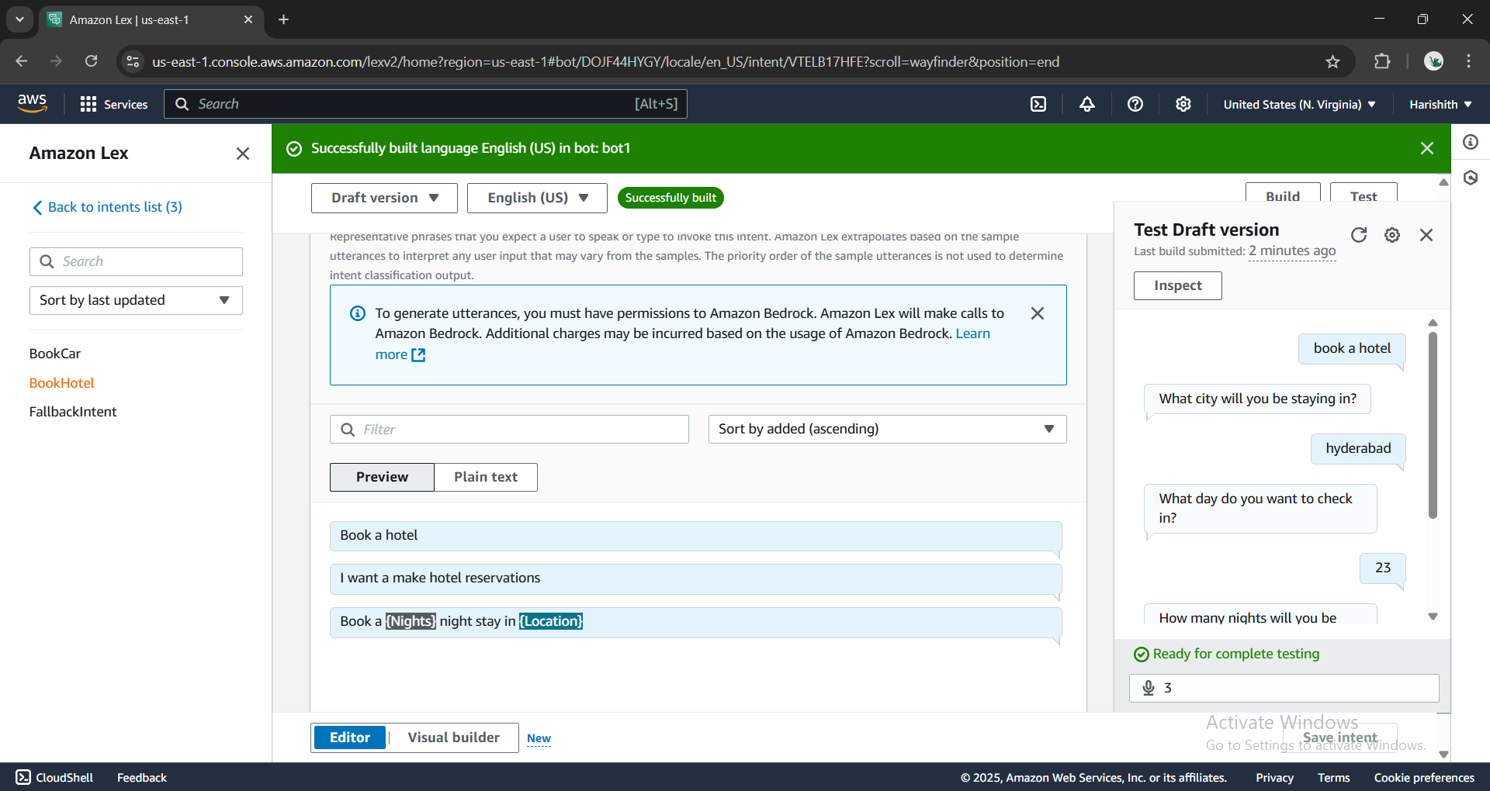
Results and Outputs

Slide 8
Challenges and Solutions
Challenge: Speech recognition errors with varied accents or unclear input Solution: Trained Lex with diverse sample utterances and used slot prompts for clarification.
Challenge: Managing backend logic without traditional servers Solution: Used AWS Lambda for serverless processing and handled logic in a scalable way.
Challenge: Ensuring secure access between services Solution: Configured proper IAM roles and policies to control permissions.
Challenge: Handling long or complex responses Solution: Broke down responses into shorter parts and used Polly to deliver them clearly.
Challenge: Monitoring errors and performance Solution: Integrated Amazon CloudWatch to log events and track issues in real time.

Slide 9
Learnings & Takeaways
Serverless Architecture: Built scalable apps using AWS Lambda without server management.
Voice Interaction: Created conversational interfaces with Amazon Lex.
Text-to-Speech: Used Amazon Polly for realistic speech conversion.
AWS Integration: Integrated AWS services to build a seamless solution.
Security: Secured services with proper IAM roles and policies.
Monitoring: Used CloudWatch for performance tracking and debugging.
Scalability: Optimized serverless apps for cost-effectiveness and scalability.

Slide 10
Future Scope
Multi-Language Support: Add more languages for global use.
Better NLP: Improve intent recognition with advanced NLP.
Cross-Platform Access: Make the assistant available on mobile and smart devices.
Personalization: Customize responses based on user behavior.
Voice Security: Add voice biometrics for user authentication.
Analytics: Use data to improve the assistant’s performance.

Slide 11
References
Amazon Web Services, Inc. (2025). What is Amazon Lex? Retrieved from https://docs.aws.amazon.com/lex/latest/dg/what-is.html
Amazon Web Services, Inc. (2025). What is Amazon Polly? Retrieved from https://docs.aws.amazon.com/polly/latest/dg/what-is.html
Amazon Web Services, Inc. (2025). AWS Lambda Overview. Retrieved from https://docs.aws.amazon.com/lambda/latest/dg/welcome.html
Amazon Web Services, Inc. (2025). Amazon CloudWatch. Retrieved from https://docs.aws.amazon.com/cloudwatch/
Amazon Web Services, Inc. (2025). What is AWS Identity and Access Management? Retrieved from https://docs.aws.amazon.com/iam/latest/UserGuide/introduction.html

Slide 12
THANK YOU

